Slide 1
Physically-Based Material, where are we?
Sébastien Lagarde
Notes:
Hello,

Slide 2
Our Vision for Unity
Introduction

Slide 3
Introduction
Nowadays everything is PBR
PBR engines
PBR materials
PBR textures
PBR lighting
PBR beers
Notes:
Pabst blue ribbon (PBR) beer

Slide 4
Introduction
Everything is PBR nowaday
PBR engines
PBR materials
PBR textures
PBR lighting
PBR beers
What is a physically-based material?
Notes:
Within this PBR zoo, let’s try to understand what a physically based material actually means

Slide 5
Introduction
But what does “physically-based” actually mean?
Derive from light-matter interaction
Follow physical rules
Energy conservation
Have representation with metrics in real world
i.e geometry with measurable properties
Lighting and material are separated
Notes:
Rendering engineers tend to talk about physically inspired materials rather than physically based

Slide 6
Introduction
Everything is PBR nowaday
PBR engines
PBR materials
PBR textures
PBR lighting
PBR beers
What is a physically based texture?

Slide 7
Introduction
No definition, but will make one for this talk
Physically-based textures are inputs for the physically-based material
Physically-based textures can contain measured (e.g. scanned) real-world data

Slide 8
Introduction
Today's talk
Definition of a physically based material
Restrict to bidirectional reflectance distribution function (BRDF)
Diffuse / Specular
No time to cover transparency, volume, non-local subsurface
Current and future real-time material model
Current physically based texture workflow
Notes:
Rendering of transparency is covered by [McGuire16], M. McGuire, Peering Through a Glass, Darkly at the Future of Real-Time Transparency, Siggraph 2016

Slide 9
Our Vision for Unity
Physically based material?

Slide 10
Physically based material?
How do we know we are physically based?
Compare to the real world?

Slide 11
Physically based material?
How do we know we are physically based?
Compare to the real world?
Real world IS the reference
But not practical
No parameter control
Many sources of noise
Hard to make a comparison

Slide 12
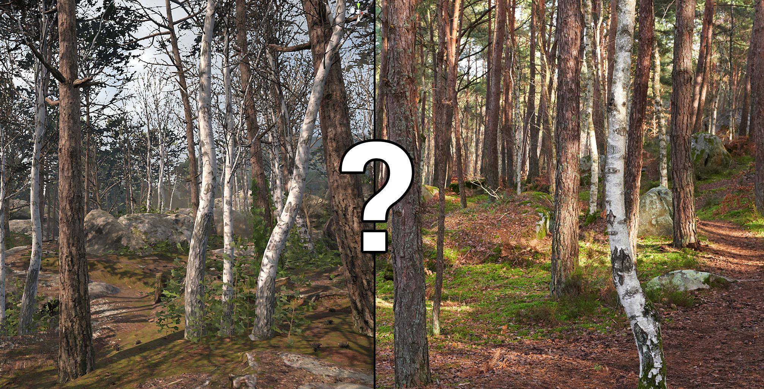
Notes:
Of course, the real world is right image, the purpose of this comparison is to show that the real world is hard to compare to: different lighting conditions, multiple material layers, layout, point of view, camera response curve, etc..

Slide 13
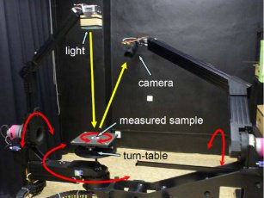
Physically based material?
Compare to controlled real world?
Measurements provide good reference
But be aware of device limitation
Often not discussed in publication
Example: Incorrect acquisition near
grazing angles / backscattering
[MERL06]
Still good for highlight shape
Image from “BRDF Slices: Accurate Adaptive Anisotropic Appearance Acquisition”, J. Filip 2013
Notes:
There is plenty of measurement devices available with more or less complex apparatus.
Some can be really accurate like the new reflectometer of Wenzel Jakob but most suffer from limitations of optics.
Issues with BRDF measurement:
Light sources: angular size, brightness, stability, speckle
Detector: Angular size, sensitivity, noise, resolution
positioning: accuracy, drift, hysteresis
For example the MERL database apparatus does not correctly capture the reflectance at grazing angles.
[MERL06] https://www.merl.com/brdf/
Still measurements like MERL are useful to compare highlight shape

Slide 14
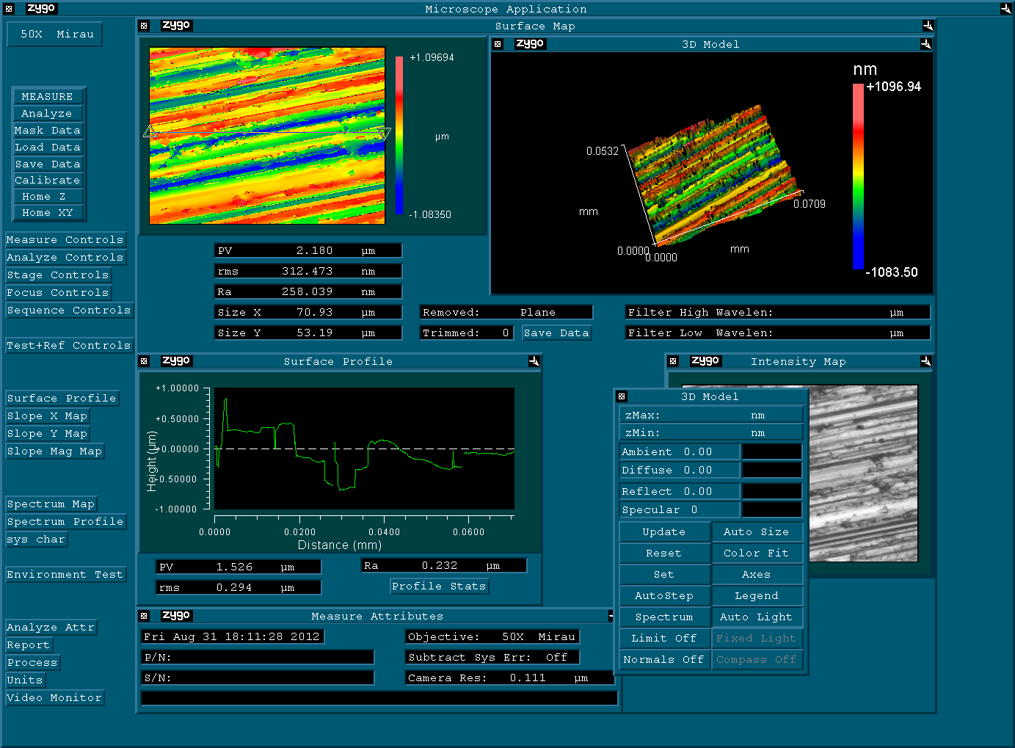
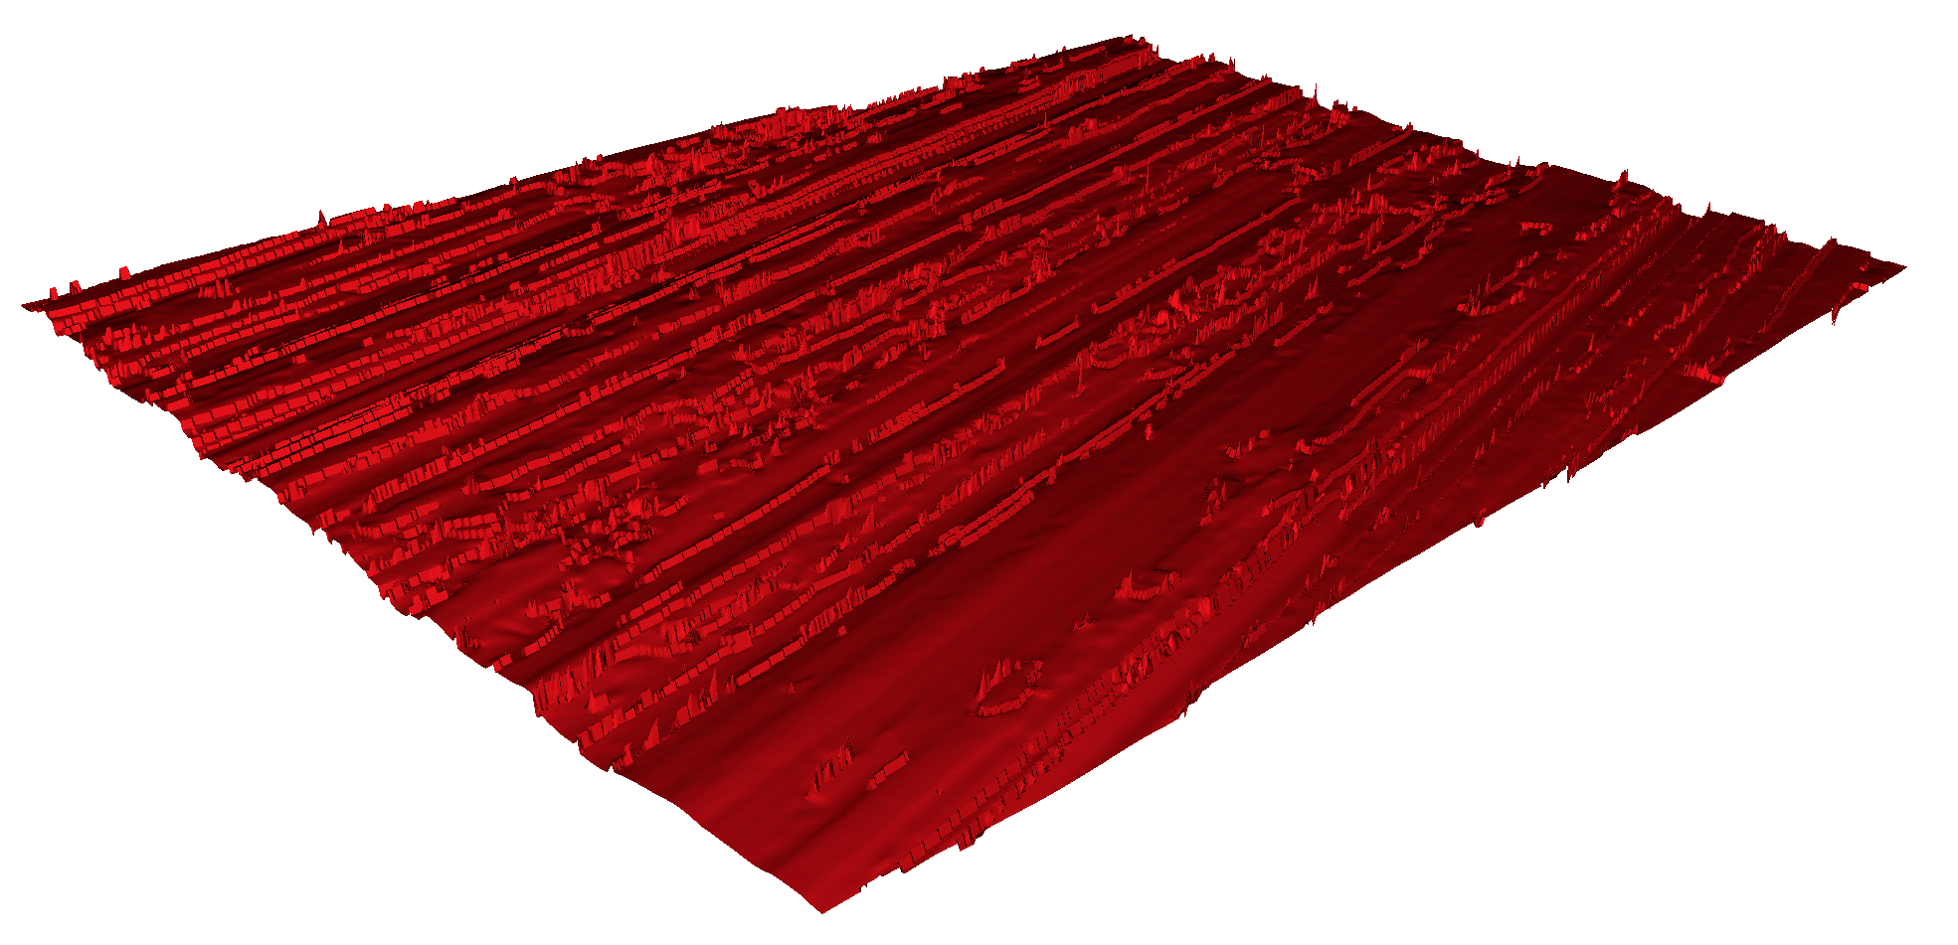
Physically based material?
Measurements are not just about RGB reflectance
Complex devices provide advanced information
Spectral measurement
Microsurface measurement
Needs more widespread adoption
Notes:
Having Microsurface measurement could help for several material validation

Slide 15
Physically based material?
But BRDF fit to measurements != Physically-based
Fitting process is similar to compression
Fitted values can be unintuitive
BRDF can rely on non physical assumption
Shifted Gamma Microfacet [Bagher12] add an inverse Fresnel term to get better fitting
Notes:
[Bagher12] M. Bagher, “Accurate fitting of measured reflectances using a Shifted Gamma micro-facet distribution”, 2012
Something important to note is that the fitting process is pure mathematics. It can be see as compressing the data.
When fitting a brdf, you can get a good fit but with very unintuitive parameters.
Also the BRDF can be created with non physical assumption.
For example the (SGD) Shifted Gamma Microfacet distribution have added a negative Fresnel term to match MERL database.
https://hal.inria.fr/hal-00702304/file/paper.pdf

Slide 16
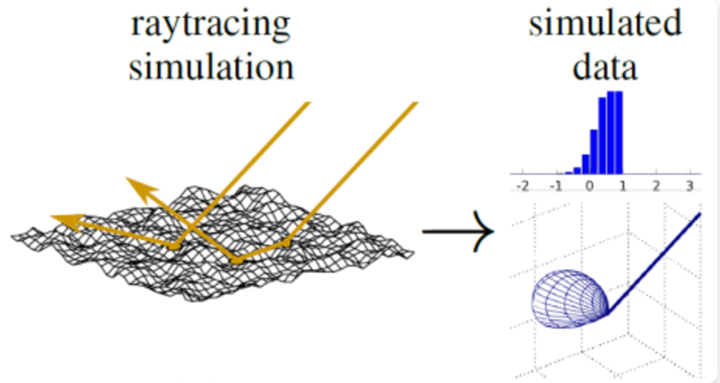
Physically based material?
Simulated data?
Based on physical/optics rules
Free of noise
Parameters controls
Easier to compare with
Can isolate terms
Single bounce / multiple bounce
...
Image from “Multiple-Scattering Microfacet BSDFs with the Smith Model, E. Heitz Siggraph 2016

Slide 17
Physically based material?
How do we know we are physically based?
The key is to combine measurements and simulation
Validate simulated data using measurements
Measure microsurface data and do simulation based it
Based on such approach researchers have established various theories to represent material
Let’s explore one of them: Microfacet theory

Slide 18
Microfacet BRDF
Start with this BRDF equation
Notes:
Cook-Torrance BRDF

Slide 19
Microfacet BRDF
Bigger one please!

Slide 20
Microfacet BRDF
Not a math talk but want to explain certain concepts
[Heitz14] provides a framework for microfacet BRDFs
A set of rules to follow to be physically based
Below is the general microfacet equation
Notes:
[Heitz14] E. Heitz, Understanding the Masking-Shadowing Function in Microfacet-Based BRDFs, JCGT

Slide 21
Microfacet BRDF
Pm: Facet BRDF
Pure Lambertian or pure specular
D: Normal distribution function (NDF)
G2: Shadowing-Masking term derived from D
This defines a BRDF
Notes:
We now construct the BRDF upon the distribution of visible normals.
The radiance L(ωo,ωm) of each microfacet can be expressed in terms of the facet BRDF ρM (ωo,ωi ,ωm) associated with each microfacet and integrated with the incident radiance L(ωi) over the domain of the incident directions Ωi (we reserve Ω for the space of the normals):

Slide 22
Facet BRDF
Pm: Facet BRDF - pure specular
Notes:
With a pure specular we get back familiar Cook-Torrance BRDF

Slide 23
Facet BRDF
Pm: Facet BRDF - pure Lambertian
Notes:
With pure Lambertian, we still have complex integral… This is a physically based diffuse term.

Slide 24
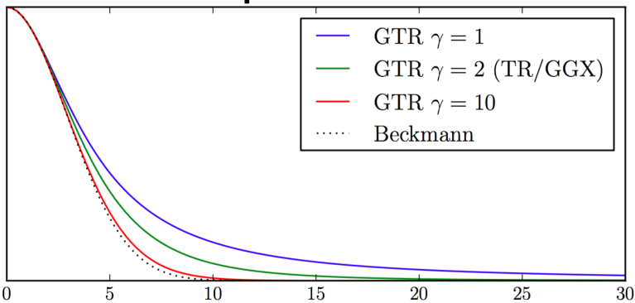
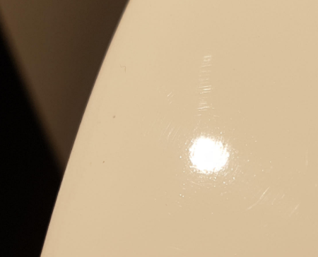
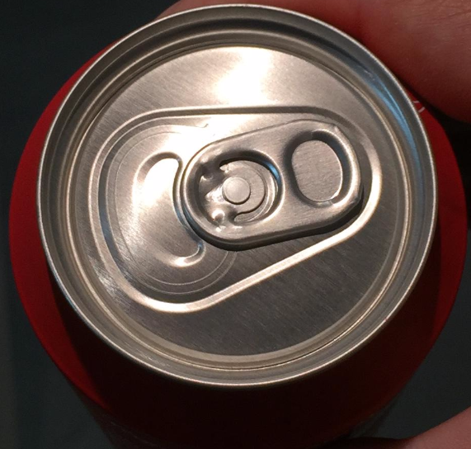
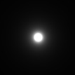
D: NDF
Isotropic or anisotropic
Like a curve driving the highlight shape
Images from “Physically based shading at Disney”, B. Burley Siggraph 2012

Slide 25
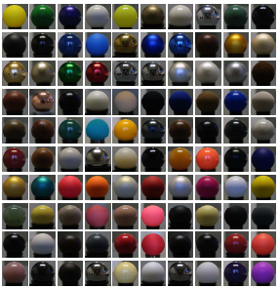
D: NDF shape
Phong, Beckmann, Trowbridge-Reitz (GGX), etc…
GGX is proven to better match measurements
But several materials have a narrower peak and a longer tail
What could be a good shape ?
Image from “The MERL BRDF database”, MERL 2007
Notes:
GGX have been proven to be a better match, but it doesn’t match all measurement
[MERL06] https://www.merl.com/brdf/

Slide 26
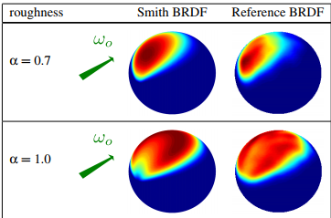
G2: Shadowing-masking
Smith’s height-correlated function
Microfacets with higher elevation are more visible
Unlike uncorrelated Smith
Proved by simulation to be more accurate
From Gaussian Heightfield...
Images from “Understanding the Masking-Shadowing Function in Microfacet-Based BRDFs”, E. Heitz, jcgt
Notes:
A more accurate form of the masking-shadowing function models the correlation between masking and shadowing due to the height of the microsurface. Intuitively, the more a microfacet is elevated within the microsurface, the more the probabilities of being visible for the outgoing direction (unmasked) and for the incident direction (unshadowed) increase at the same time. Thus, masking and shadowing are correlated through the elevation of the microfacets.
Note: Accuracy of height-correlated has been validated by brute force simulation on gaussian surface in
[Heitz14] E. Heitz, Understanding the Masking-Shadowing Function in Microfacet-Based BRDFs, JCGT

Slide 27
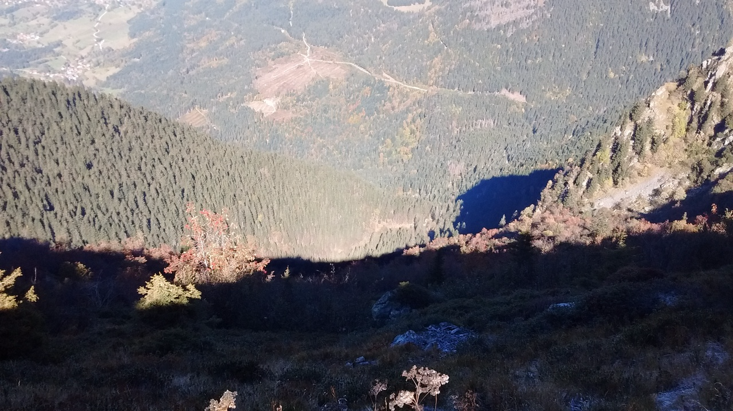
G2: Shadowing-masking
End of story?
Real world observation not handled by Smith’s height-correlated term
Hotspot/opposition effect
View and light are aligned
No more occlusion

Slide 28
G2: Shadowing-masking
[Heitz14] Provide a better candidate term
Height-Direction-Correlated Masking and Shadowing
Open problem is to find 𝝺 in this equation
Notes:
[Heitz14] E. Heitz, Understanding the Masking-Shadowing Function in Microfacet-Based BRDFs, JCGT
Masking and shadowing are also strongly correlated when the outgoing and incident directions are close to one another. Typically, when ωo = ωi , masking and shadowing are perfectly correlated because microfacets visible from direction ωo are also visible from direction ωi . In this case, the shadowing should be removed from the BRDF because shadowed microfacets are not visible from direction ωi , and thus they are also not visible from ωo. This is known as the “hotspot effect”: when the view and light directions are parallel, shadows disappear. Since the BRDF models the radiance measured along the outgoing direction, if shadowing exists on the surface but is not visible then it should not be part of the BRDF
Here, masking and shadowing are fully correlated when the outgoing and incident directions are parallel and λ = 0
The derivation of practical forms for λ and generalization non-Gaussian distributions are open problems

Slide 29
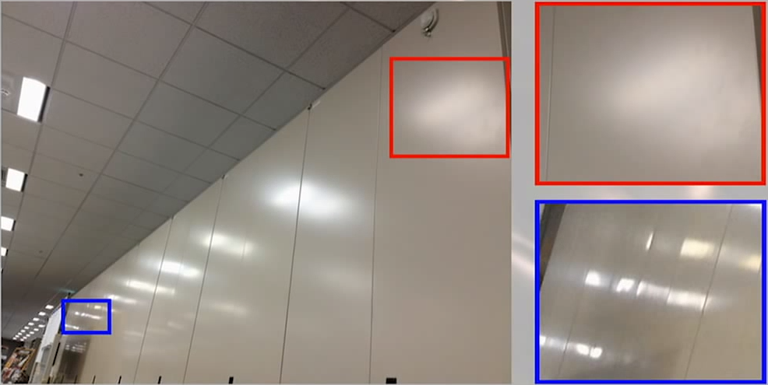
Shadowing-masking
Other problem: view-dependent roughness
Rough surfaces appear smoother at grazing angles
Fresnel is not enough to explain this behavior
Question: All surfaces don’t follow Smith’s hypothesis?
Need new shadowing/masking?
Diffraction at grazing angles?
Microsurface measurement
could help
Image from “Hideo Kojima GDC 2013 Panel - MGS5 & Fox Engine“
Notes:
View dependent roughness term have been introduced at GDC 2013 in the panel about MGS5 and the fox engine. But there is not really further research on the topic.
Still the phenomena exist, at grazing angles some surfaces are mirror like and is not due to Fresnel but rather due to visible normal.
Note from Naty Hoffman: It raise other questions "Don’t follow smith hypothesis" which is all that's needed for the distribution of visible normals to change with view direction
(the Smith assumption - that visibility and orientation are uncorrelated - is in effect assuming that the distribution of visible normals does not change)
Note: Artists handle it in shader graph with roughness and view vector. Not physically based, no reciprocity

Slide 30
Beyond microfacet BRDFs?
[Holzschuch17] Introduce Diffraction term in addition to Specular term
Terms fits well with a corrected MERL database
Results show cases where Diffraction part seems to match plausible physical phenomena behavior
Should we update the BRDF definition then?
Specular
Diffraction
Image from “A Two-Scale Microfacet Reflectance Model Combining Reflection and Diffraction”, N. Holzschuch, Siggraph 2017
Notes:
[Holzschuch17] N. Holzschuch, A Two-Scale Microfacet Reflectance Model Combining Reflection and Diffraction, Siggraph 17
This paper show that diffraction effects in the micro-geometry provide a plausible explanation to observe discrepancy of reflectance with microfacet model prediction.
It introduce a two-scale reflectance model, separating between geometry details much larger than wavelength and those of size comparable to wavelength.
The former model results in the standard Cook-Torrance model. The latter model is responsible for diffraction effects.

Slide 31
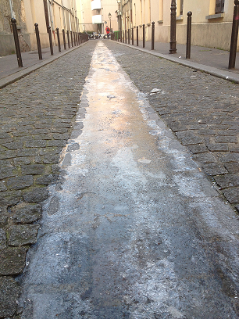
Multiscale Representation
A physically based materials conserve its appearance at all scales
Material stay rough, anisotropic, glinty... with distance
Related to normal
distribution on surfaces

Slide 32
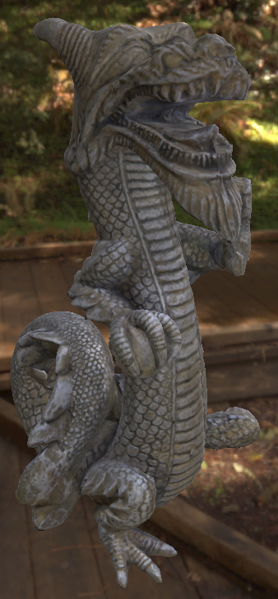
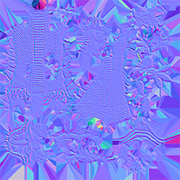
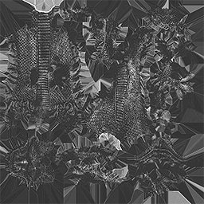
Multiscale Representation
In computer graphics (CG) normal distribution are represented at various scale by
Vertex normal (Macro), Normal map(Meso), Roughness map (Micro - D)

Slide 33
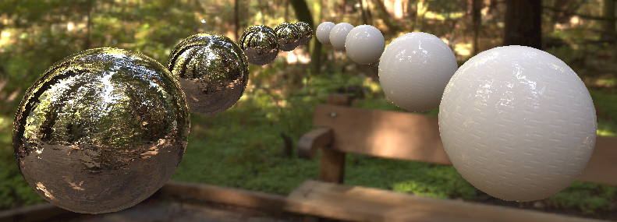
Multiscale Representation
Smooth with distance ?
Notes:
These representations have filtering issues. For example, when using normal map to add details
Normal are averaged by mipmap, a very well know problem. With distance the object become smooth.

Slide 34
Multiscale Representation
Aliasing
Notes:
Some artists try to disable mipmaps to solve it but then introduce aliasing

Slide 35
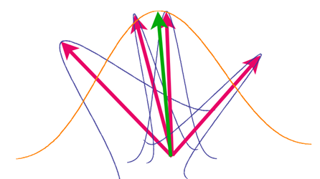
Multiscale Representation
Similar issue happens with normal geometry filtering
How to conserve appearance at all scale in CG?
Fold all pixel’s footprint surface information to an NDF (i.e. new D)
Transfer information from one scale to the other. But how ?
The problem applies to both diffuse and specular BRDF
Images from “How to design your assets for physically based rendering”, Y. Gotanda, Cedec 2012
Notes:
Note that the multiscale problem don’t apply only to specular but also to diffuse. Both derive from the same NDF.

Slide 36
Energy conservation
Energy conservation?
We hear about it all the time with PBR
No energy loss in ideal condition with no absorption
NDFs must be normalized
BRDFs must pass the white furnace test
White environment lighting a sphere with Fresnel term = 1 result in white sphere
Image from “Extending the Disney BRDF to a BSDF with Integrated Subsurface Scattering”, B. Burley, Siggraph 2015
Notes:
A white furnace test is like putting a white sphere with a BRDF where Fresnel term is set to 1 in a white environment, the sphere should be white if it passes the test, i.e is energy conserving

Slide 37
Energy conservation
Almost all current BRDF fail the white furnace test
Rougher materials are darker due to energy loss
Because they only model single scattering
[Heitz16] introduce a multiple scattering framework
A physically based material is multiscattering
Increasing roughness
Images from “Multiple-Scattering Microfacet BSDFs with the Smith Model”, E.Heitz, Siggraph 2016
Notes:
[Heitz16] E. Heitz, Multiple-Scattering Microfacet BSDFs with the Smith Model, Siggraph 2016

Slide 38
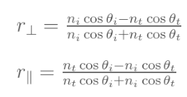
Energy conservation
We just discussed energy conservation of a BRDF
What about energy conservation between BRDFs?
This requires defining a physical representation
Important for layered BRDFs
And this is where the Fresnel term comes into play

Slide 39
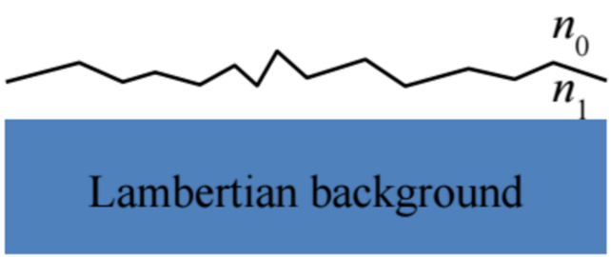
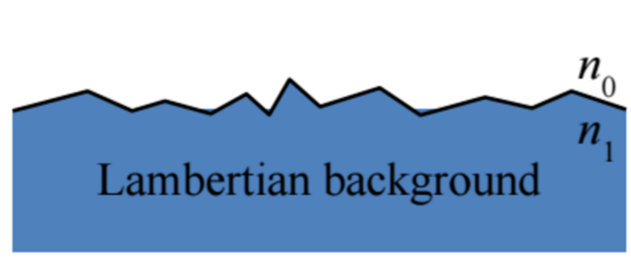
Energy conservation
We can consider different physical representations
Specular BRDF on top of diffuse BRDF
Specular + Diffuse as a BRDF
Subsurface scattering distance is small as compared to the size of the microstructure
Don’t fit most materials but doesn’t mean the resulting visual is not good
Others…
Image from “Rendering Rough Opaque Materials with Interfaced Lambertian Microfacets, D. Meneveaux, 2017

Slide 40
Sum up
What is a physically based material?
Based on a physical representation
Energy conservation
Multi scattering, layered Fresnel interfaces
NDF Shape that match measurement
Isotropic and anisotropic
Diffuse and specular term derived from normalized NDF
Multiscale representation
Let’s see what's available out there
Notes:
Energy conservation inside and between BRDF

Slide 41
Our Vision for Unity
Where are we
(in real-time rendering)?

Slide 42
Real-time BRDF
Desired properties for real-time game engines
Few artist-friendly parameters
G-buffer storage, texture budget
Mapped to [0..1] and perceptually linear
BRDF must interact correctly with all lighting
Global illumination (GI), area and environment lights
Rely on pre-integration of lighting and NDF for real-time performance
Called “lighting coherency” in this talk
Notes:
Sadly global illumination (indirect diffuse only, abuse term by game engine, i.e. in this case from lightmap/lightprobe), area and environment lights integration are often not considered when adding new material in an engine. It is important that a material interact correctly with a giving light type.
Lighting and material are decoupled on artists side but are often coupled on the code side for performance reasons (only for cubemap, for GI and area it is currently only a pre-integratoin of the BRDF on a given solid angle, unless the area light is textured)
Coherency for both diffuse and specular terms
The problem with pre-integration is dimensionality explosion.

Slide 43
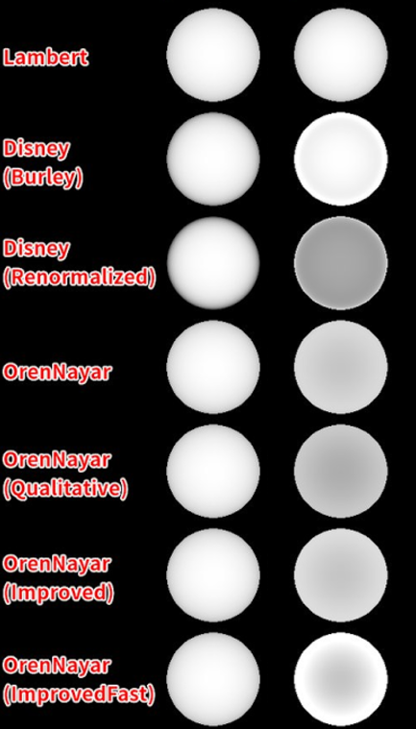
Real-time diffuse BRDF
Lambert still strongly present
Oren-Nayar [Oren94]
Torrance-Sparrow V-Cavity microfacet
Use angular roughness, not slope roughness
Few variants [Fujii][Gotanda12][Gotanda14]
Disney diffuse [Burley12]
Empirically based on [MERL06]
Not energy conserving - attempt from Frostbite [Lagarde14]
Lighting coherency often missing
Image from Hiroyuki Sugiyama, use with permission
Smooth Rough
Notes:
[Oren94], M. Oren, S. Nayar, Generalization of Lambert’s Reflectance Model, Siggraph 1994
This paper also propose the Qualitative mode
Oran-Nayar derive equations using numerical integration, but rely on the Torrance-Sparrow V-Cavity model. A model from the “old time” ☺
[Fujii] Y. Fujii, A A tiny improvement of Oren-Nayar reflectance model
This paper introduce Improved, ImproveFast
[Gotanda12] Y. Gotanda, Beyond a Simple Physically Based Blinn-Phong Model in Real-Time, Siggraph 2012
This paper introduce optimization
[Gotanda14] U. Gotanda, Designing Reflectance Models for New Consoles, Siggraph 2014
This paper introduce energy conservation with a Fresnel term
[Burley12] B. Burley, Physically based shading at Disney, Siggraph 2012
Derive from observation of MERL database
Disney: Darkening at incoming/outgoing grazing angle for smooth surface, brightening for rough (Backscatter)
Note that this behavior is due to their choice of term separation
Note: the Disney BRDF has a Sheen term to compensate for the energy loss due to the lack of multiple scattering
It is not energy conserving, Lagarde and de Rousiers attempted to make it energy conserving but doesn’t look it is the correct way to do it.
Lighting coherency is often missing in game engine. If disney or Oren-Nayar is use, it must be integrated with lightmap/lightprobe too.
And Lightmaper often work with Lambert only, relying on a post-step approximation to make it coherent. Same thing for the area lights.

Slide 44
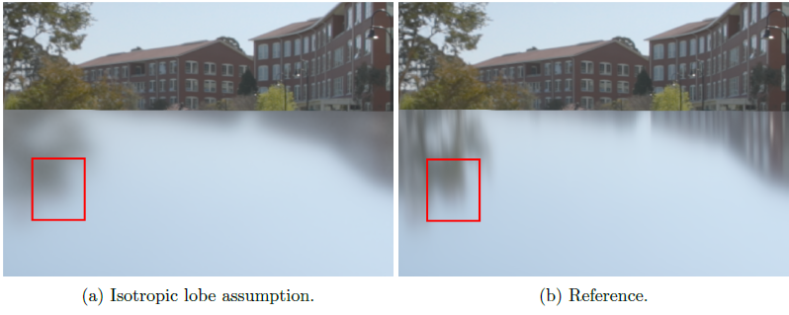
Real-time specular BRDF
Trowbridge-Reitz (GGX)
With Smith’s Height-correlated Masking-Shadowing function
Lighting coherency is often supported
Environment pre-integration
With simplifications [Karis13]
L = V
Area lights pre-calculation
Linear cosine transform
[Heitz16b]
Image from “Moving Frostbite to PBR”, S. Lagarde, Siggraph 2014
Notes:
[Karis13] B. Karis, “Real Shading in Unreal Engine 4”, Siggraph 2013
[Heitz16b] E. Heitz, “Real-time polygonal-light shading with linearly transformed cosines”, Siggraph 2016
Environment map integration in game rely on split integral approximation popularized by Karis (But Gotanda have presented it in 2010 and Drobot also in a presenation of KZ4 before him).
The lighting and the NDF is coupled in this case.
The pre-integration of cubemap is simplified to reduce dimensionality explosion with L = V in pre-integration step, resulting in missing grazing angle stretching effect in practice
In the case of area lights, there is a pre-calculation of a matrix transformation to convert from specular lobe to diffuse lobe. With textured area lights, the textures also need to be pre-integrated with the NDF

Slide 45
Real-time BRDF
Going further?
More physically-accurate diffuse BRDF
NDF shape
Anisotropy, shape control
Multiscale representations
Multiple scattering
Iridescence / Thin-film

Slide 46
Real-time BRDF
Going further?
More physically-accurate diffuse BRDF
NDF shape
Anisotropy, shape control
Multiscale
Multiple scattering
Iridescence / Thin-film

Slide 47
More physical diffuse BRDF
More physically-accurate diffuse
Inherits properties of the chosen NDF
Example: Anisotropic GGX diffuse BRDF
Need an efficient approximation (a la Oren-Nayar)
[Gotanda15] and [Hammon17] provide an approximation for isotropic Height-Correlated GGX diffuse
Use Fresnel Schlick
[Gotanda15] use Facet BRDF:
Expensive approximation
Image from “Designing Reflectance Models for New Consoles”, Y. Gotanda, Siggraph 2014
Notes:
[Gotanda15] Y. Gotanda, Designing Physically Based Microfacet Models for Next Generation, Cedec 2015
[Hammon17] E. Hammon, PBR Diffuse Lighting for GGX+Smith Microsurfaces, GDC 2017
Gotanda have provide an expensive approximation with a Facet BRDF that include Schlick Fresnel term to consider energy conservation. But this term is not physical as it is not reciprocal

Slide 48
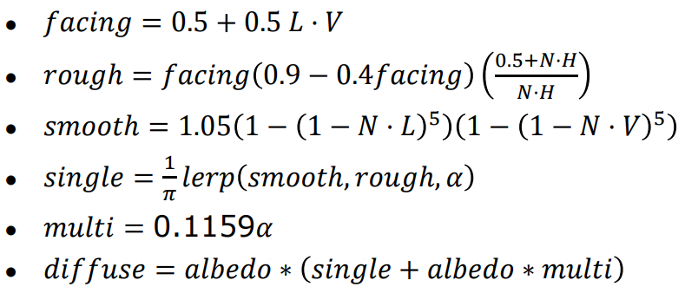
More physical diffuse BRDF
[Hammon17] use Facet BRDF:
Used in Titanfall 2
Derived energy conservation term is the same than [Shirley95]
Include reciprocity
How to achieve lighting coherency?
Image from “PBR Diffuse Lighting for GGX+Smith Microsurfaces”, E. Hammon, GDC 2017
Notes:
[Shirley57] P. Shirley, A Practitioners’ Assessment of Light Reflection Models, 1995 Equation (5)
[Hammon17] E. Hammon, PBR Diffuse Lighting for GGX+Smith Microsurfaces, GDC 2017
The facet BRDF term is more complete than the one from Gotanda as it is reciprocal. It also match the derivation from Shirley for energy conservation between specular and diffuse. But this derivation is based on Fresnel Schlick, not the real Fresnel term.
Note 1.05 is 21 / 20 as in Shirley and Gotanda attempt
new consensus ?
Hammon exhibit darkening at smooth edge and backscattering, similar properties as Disney difffuse. But Hammon have use his model only for direct lighting, not indirect lighting.
For lighting coherency we may pre-integrate single and multi in two different term to apply on albedo and albedo square.
What about LTC for area Light ?

Slide 49
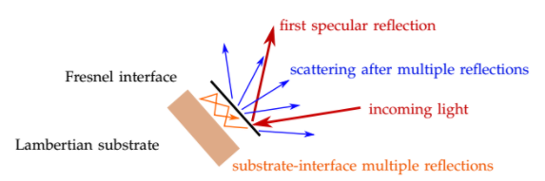
More physical diffuse BRDF
[Meneveaux17] uses Facet BRDF:
Exact Fresnel and interface multiple reflection
Not for real-time
Image from “Rendering Rough Opaque Materials with Interfaced Lambertian Microfacets, D. Meneveaux, 2017
Notes:
[Meneveaux17] D. Meneveaux, Rendering Rough Opaque Materials with Interfaced Lambertian Microfacets, 2017
Previous BRDF use Shlick Fresnel, but to do it correctly it should use exact Fresnel Term and take into account the multiple reflection within the Fresnel interface.

Slide 50
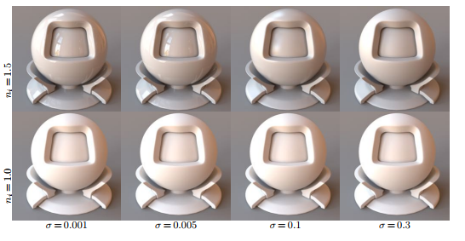
More physical diffuse BRDF
[Meneveaux17] non real-time approximation provided for anisotropic Beckmann with uncorrelated smith diffuse
Image from “Rendering Rough Opaque Materials with Interfaced Lambertian Microfacets, D. Meneveaux, 2017
Notes:
[Meneveaux17] D. Meneveaux, Rendering Rough Opaque Materials with Interfaced Lambertian Microfacets, 2017
There is darkening at smooth edge and backscatter behavior like with Hammon.

Slide 51
More physical diffuse BRDF
Previous approaches use Specular + Diffuse as a BRDF for physical representation
Specular and diffuse use same roughness
Convenient for games since it has fewer parameters
Don’t match most of real world surface representation
Image from “Rendering Rough Opaque Materials with Interfaced Lambertian Microfacets, D. Meneveaux, 2017
Notes:
Previous approach follow a physical representation of specular+diffuse BRDF that I describe in previous section, it mean that diffuse and specular have the same properties, like same roughness.
This is convenient but this representation doesn’t match most of real world surface. Maybe a better way will be to handle diffuse BRDF and specular BRDF as layer instead,

Slide 52
More physical diffuse BRDF
Specular BRDF on top of diffuse BRDF instead ?
Fresnel term is not in Facet BRDF but between the BRDF layers
Separate roughness
More control for the artists
Common in VFX industry
Find efficient approximation for anisotropic Height-Correlated GGX diffuse BRDF with correct Fresnel interface with Specular BRDF ?
Image from “Rendering Rough Opaque Materials with Interfaced Lambertian Microfacets, D. Meneveaux, 2017
Notes:
Roughness for diffuse will be different from roughness of specular. This provide more control by the artists and is already a well established practice in VFX industry.
Then the problem is to find an approximation for a simple Facet BRDF of 1/PI. Should be easier than what have been done by previous work.
Most difficult part is to find a correct approximation from a Rough Specular, Rough diffuse Fresnel interface with multiple reflection.
Still it require one extra roughness parameters (2 for anisotropy), thus why game it is not use in game due to gbuffer storage.

Slide 53
Real-time BRDF
Going further?
More physically-accurate diffuse BRDF
NDF shape
Anisotropy, shape control
Multiscale
Multiple scattering
Iridescence / Thin-film

Slide 54
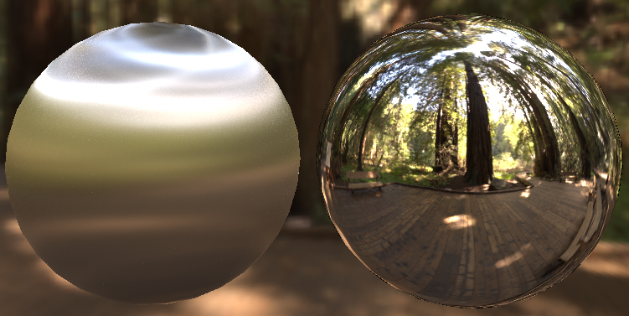
NDF shape - anisotropy
Few game engines use the anisotropic GGX NDF
Requires tangent + extra roughness parameters
Roughness often remapped from anisotropy factor [Burley12]
Visibility term must be derived from anisotropic NDF
Notes:
[Burley12] B. Burley, Physically based shading at Disney, Siggraph 2012
Anisotropy is not something that is common in game engine due to its cost and extra complexity
Something often missed is shadowing and masking term derive from NDF, and thus if the NDF is anisotropic, the visibility term is.

Slide 55
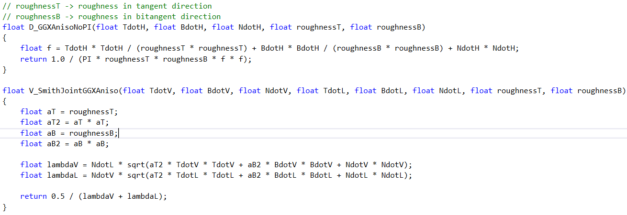
NDF shape - anisotropy
After simplification (Height correlated visibility term: G pre divide by (4.0 * NdotL * NdotV)) [McAuley15]
Notes:
[McAuley15] S. McAuley, The rendering of far cry 4, Cedec 2015

Slide 56
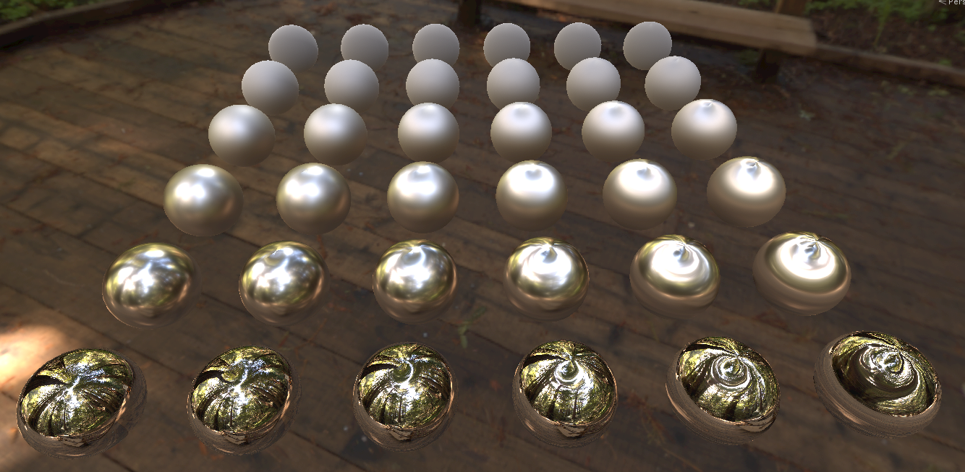
NDF shape - anisotropy
Lighting coherency is very hard: Dimensionality
Games use a normal vector hack [Revie11][McAuley15]
Notes:
[Pesce15] A. Pesce, M. Iwanicki, Approximate Models For Physically Based Rendering, Siggraph 2015 - no hardware anisotropic filtering for cubemap
[Revie11] D. Revie, Implementing Fur Using Deferred Shading, GPU Pro 2
[McAuley15] S. McAuley, The rendering of far cry 4, Cedec 2015
Supporting pre-integration with cubemap is not possible due to dimmensionnality. Game rely on a normal vector hack introduce by Revie and use in Far car 4 and The order 1886.
The hack simply bend the normal vector based on anisotropy and view direction. It still perform a single fetch. Which is convenient.
It may be visually pleasant but I want to show how far it is from the referene.
Note that when moving the camera, the highlights also move (inherent to the hack use), whereas the highlight must be stable.

Slide 57
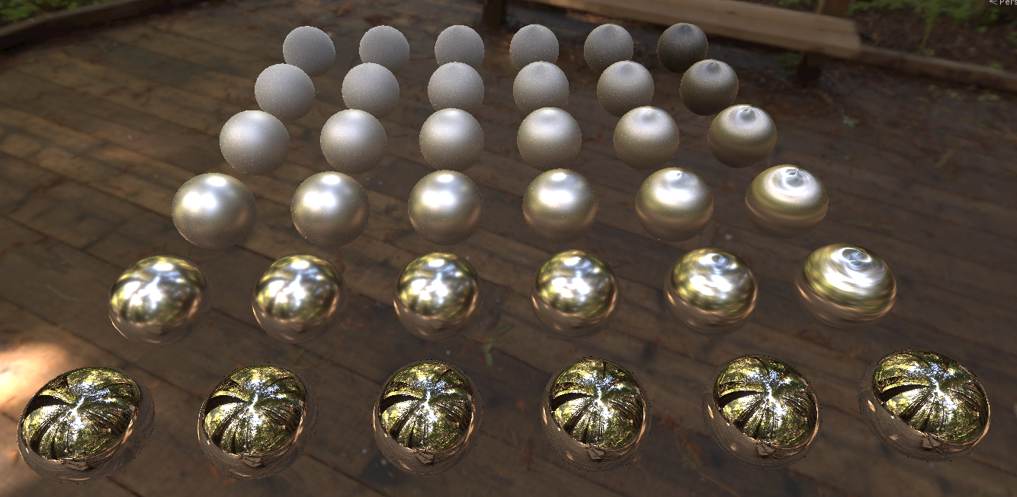
NDF shape - anisotropy
But it is far from the reference
Need a better hack
And with the current hack highlights move with the camera
Notes:
Noise is due to undersampling.
Reference done in engine with importance sampling of anisotropic GGX.
See how the smooth case is totally wrong. When you are smooth, there is no anisotropy.
We need a better hack that handle this case and stretch the highlight more closely. (Unless someone found a good accurate way to do it ☺ ).

Slide 58
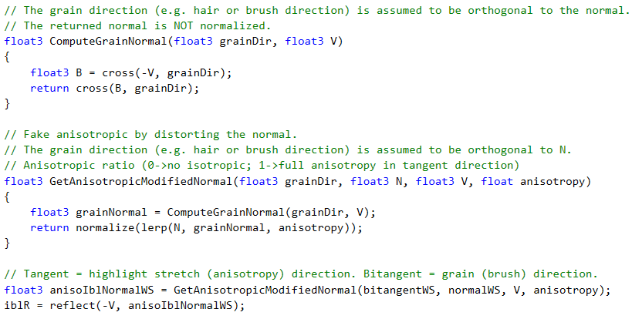
Specular anisotropy - Hack

Slide 59
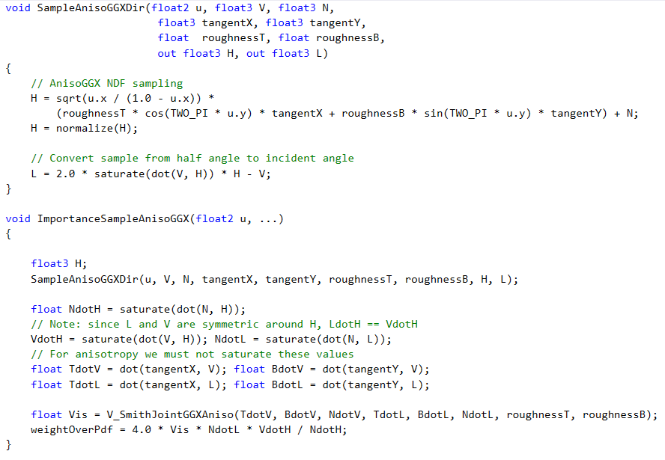
Specular anisotropy - Ref

Slide 60
NDF shape - more control
Generalized Trowbridge & Reitz (GTR) [Burley12]
𝛄 [0..10], match GGX for 𝛄 = 2, singularity at 𝛄 = 1
Not shape-invariant
Shadowing-Masking function is hard to derive
Discrete value of 𝛄 in (0, 4] spline interpolated [Dimov15] for height-correlated visibility term
Images from “Physically based shading at Disney”, B. Burley Siggraph 2012
Notes:
[Burley12] B. Burley, Physically based shading at Disney, Siggraph 2012
[Dimov15] R.Dimov, Deriving the Smith shadowing function G1 for γ in (0, 4], Chaos group documentation 2015
Shape-invariant property is important as it allow to more easily derive a shadowing and masking term and perform other operation. Here GTR is not invariant, so it is hard to find an analytic term for shadowing and masking.
Rossen Dimov from Chaos Group has derived a Smith shadowing function for discrete GTR values, and uses interpolated values in-between: Deriving the Smith shadowing function G1 for γ in (0, 4]

Slide 61
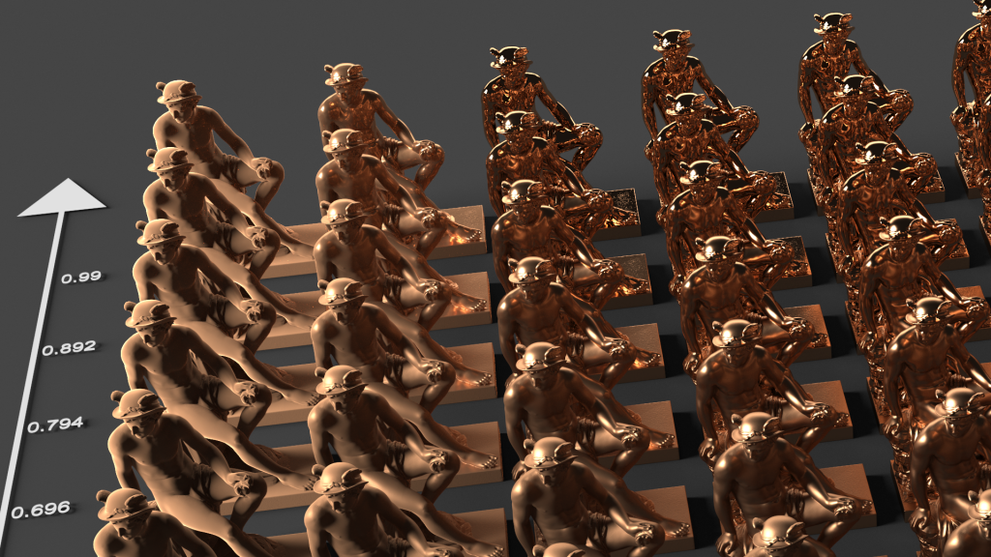
NDF shape - more control
GGX’s shadowing-masking term for everything
Roughness [0.7 to 1]
𝛄 [0.1 to 3.36]
Image from https://labs.chaosgroup.com/index.php/rendering-rd/improvements-to-the-gtr-brdf/
Notes:
Left to right is increasing gamma value from 0.1 to 3.36, bottom to top is roughness from 0.7 to 1.
GGX shadowing-masking term is use for everything

Slide 62
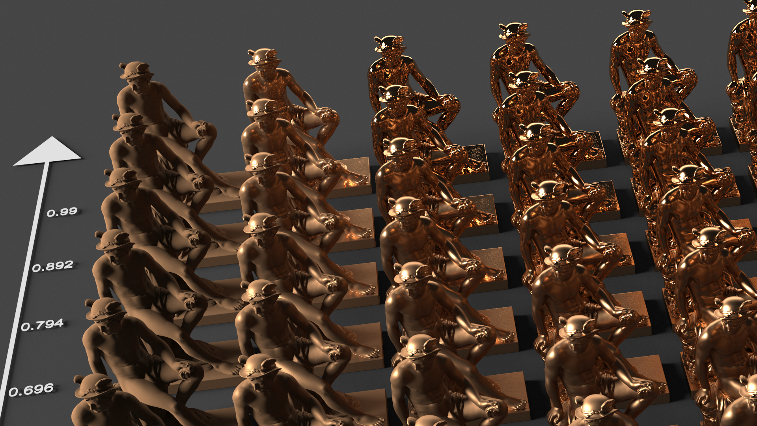
NDF shape - more control
Correct shadowing-masking term is important for rough objects
Roughness [0.7 to 1]
𝛄 [0.1 to 3.36]
Image from https://labs.chaosgroup.com/index.php/rendering-rd/improvements-to-the-gtr-brdf/
Notes:
Left to right is increasing gamma value from 0.1 to 3.36, bottom to top is roughness from 0.7 to 1.
Approximated GTR shadowing-masking, this show how it is important to use the correct term.

Slide 63
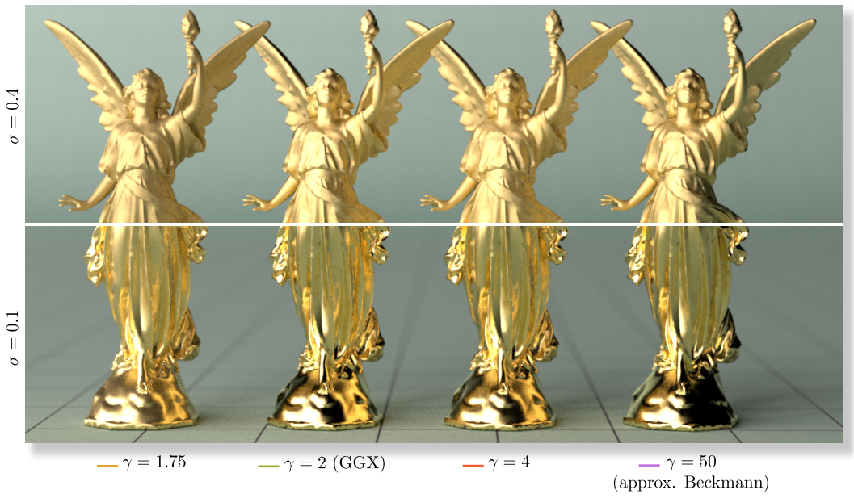
NDF shape - more control
Bivariate Student-T distribution (STD) [Ribardiere17]
𝛄 [1.5, 40], Include GGX (𝛄=2), Beckmann (𝛄 = 40), singularity at 𝛄 = 1.5
Shape-invariant
Analytic G2 term
Cons
Not real-time
Low interest for Beckmann shape vs GGX shape
Peak/Longer tail control less interesting than GTR
Image from “STD: Student’s t-Distribution of Slopes for Microfacet Based BSDFs”, M. Ribardière, eurographics 2017
Notes:
[Ribardiere17] STD: Student’s t-Distribution of Slopes for Microfacet Based BSDFs, eurographics 2017
This paper try to fix the issue with GTR and provide a shape-invariant version.
Shape enables relatively straightforward derivation of an anisotropic form, Smith G, distribution of visible normals, etc.
Their term however is really heavy, the paper also provide an approximation but it is expensive.
Also the shape control is less interesting than GTR.

Slide 64
NDF shape - more control
Want GTR shadowing-masking efficient approximation?
Lighting coherency?
𝛄 control blurriness like roughness
Want a different shape control?
Haze/Halo perception control [Vangorp17][Kulla17]
Image from “The perception of hazy gloss”, P. Vangorp, Journal of vision 2017
Notes:
Even if we adopt GTR we need an efficient approximation of the shadowing-masking term.
Also shape control increase size dimensionality of pre-integration, need one extra parameters, not compatible with cubemap... Lastly, the gamma and roughness parameter both control the blurriness aspect of the lobe, making it difficult to know which one to chose to control the shape.
[Vangorp17] P. Vangorp, “the perception of Hazy gloss”,
They show that haziness is not only a readily perceivable material quality, but that it is distinct from the blur quality
“we find that certain aspects of our data can be explained by a nonphysical decomposition into a central reflection peak flanked by a halo component. We suggest that it is the presence of the halo component that is responsible for the perception of hazy gloss. “
Two lobes, narrow and wide to simulate hazy effect.
This will be compatible with current approach, just need to run all the lighting code twice, like for layering and lerp the lobe.
It is use in production at Imagework. [Kulla17] C. Kulla, “Revisiting Physically Based Shading at Imageworks”, Siggraph 2017

Slide 65
Real-time BRDF
Going further?
More physically-accurate diffuse BRDF
NDF shape
Anisotropy, shape control
Multiscale Representation
Multiple scattering
Iridescence / Thin-film

Slide 66
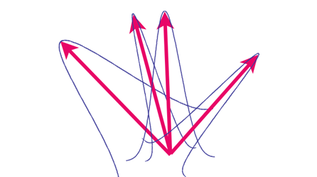
Multiscale Representation
Related to NDF and CG surface representation
What if we rely solely on an NDF instead ?
Need multiscale glinty/spiky NDF
Keep high frequency information
Query over finite areas and solid angles
i.e estimates pixel’s footprint NDF at any scale
Notes:
Remember: want to conserve appearance with distance
Queried not at a single points and directions but over finite areas and solid angles

Slide 67
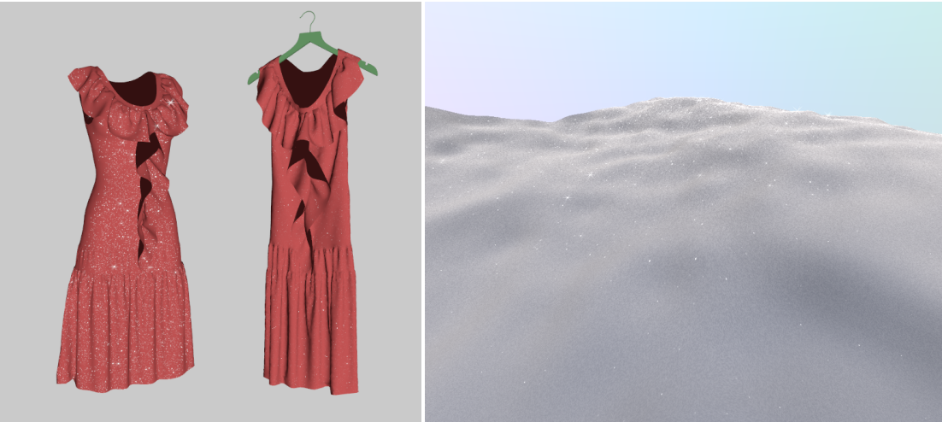
Multiscale Representation
Procedural NDF defined per pixel
Discrete Stochastic BRDF [Jakob14][Atanasov15]
Real-time rendering of procedural multiscale material [Zirr16]
Works only for one analytic light
Limited to glint/scratch
Image from “A Practical Stochastic Algorithm for Rendering Mirror-Like Flakes”, A. Atanasov and “Real-time Rendering of Procedural Multiscale Materials”, T. Zirr, I3D 2016
Notes:
[Jakob14] W. Jakob, Discrete Stochastic Microfacet Models, Siggraph 2014
Jakob et al. stochastically model the number of discrete slopes covered by the pixel footprint and can be quickly evaluated by a hierarchical subdivision of the latter in the microfacet domain.
[Atanasov15] A. Atanasov, A Practical Stochastic Algorithm for Rendering Mirror-Like Flakes, Chaos group documentation 2015
https://www.fxguide.com/quicktakes/v-rays-practical-stochastic-rendering-of-spec-y-things/
The method works by assuming that there are N ﬂakes that are uniformly distributed in a unit of texture space and their normals follow a micro-facet distribution on that unit’s rendering or lighting equation hemisphere. The multiscale BRDF is deﬁned as the microfacet BRDF, averaged over a ﬁnite surface area. In the implementation, the algorithm works with a patch or parallelogram approximation of the pixel footprint. Into this mix goes more complex techniques such as caching, overlapping sampling of the parallelograms and optimal Importance Sampling. A key advantage of the algorithm is that the ﬂakes are not stored in memory, but their counts in this patch are reproduced by a deterministically seeded stochastic process.
[Zirr] T. Zirr, Real-time Rendering of Procedural Multiscale Materials, I3D 2016
Zirr paper method: Get a random number to turn on a pixels. It is spatially and angulary stable (inside a cone we will trigger the same number).
Note: the approach is not physically based, we can see 2 glint in two different light direction at the same time (but should not be visible in practice). This is the limitation of not having a true NDF.
Define a macro and a micro NDF and compose them: In practice it is just a box filter that allow to mimic a Beckmann shape (as we do in rendering for gaussian postprocessing)

Slide 68
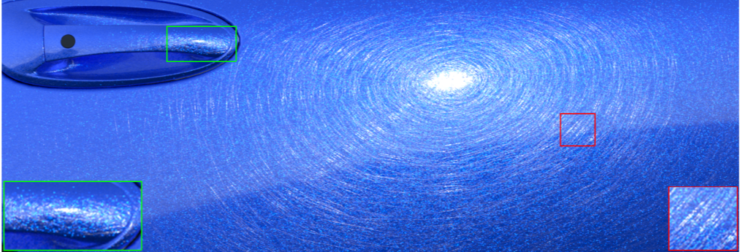
Multiscale Representation
Instead of starting from procedural NDF, use high resolution normal map to defines the pixel NDF?
Better artist-friendly control
Position-Normal distribution [Yan 2016]
Similar goal as normal map filtering algorithm
Image from “Position-Normal Distributions for Efficient Rendering of Specular Microstructure”, L. Yan, Siggraph 2016
Notes:
[Yan16], L. Yan, Position-Normal Distributions for Efficient Rendering of Specular Microstructure, Siggraph 2016
Yan proposed another method for filtering spatially varying microstructure. They handle a high-resolution normal map texture by resolving a mesoscale NDF defined on a pixel footprint by hierarchically pruning irrelevant normal map texels.
The paper represent high resolution normal with a mixture of Gaussians. Combine a macro-level standard normal map and a micro-level normal map. NDF solely defined on normal map
Defining microstructure pattern with textures is attractive for artists. Not real time
Skipped by lack of time:
Multi-Scale Rendering of Scratched Materials using a Structured SV-BRDF Model [Raymond 16]
When getting farther away, reflections from individual scratches may still remain visible even though they are much smaller than a pixel: they lead to glint lines At a distance, the distribution of scratches still has a visible impact on appeareance: it modulates highlight silhouettes and smears environment reflections. Scratched materials thus require a BRDF model that is not only spatially-varying, but also multi-scale

Slide 69
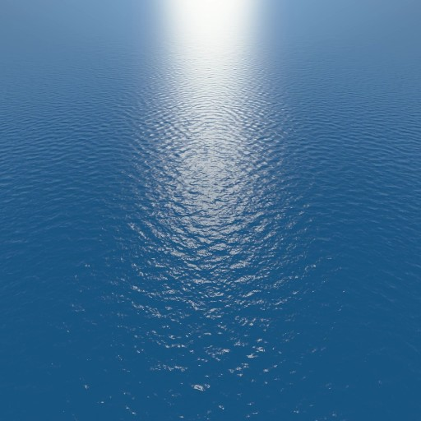
Multiscale Representation
But Toksvig[Tokvis04] / LEAN [Olano10] / LEADR [Dupuy13] have filtering issues
LEADR
Reference
Notes:
Except well-known normal map filtering algorithm don’t solve the problem fully for very far distance
Also note that none of these algorithm work with GGX.
There is also the Bum to Roughness method from Pixar
None of this algorithm rely on GGX (but Pixar claim that it is ok in their case).

Slide 70
Multiscale Representation
These algorithm can’t reproduce sharp features as normal filtering are based on smooth NDF (Beckman for LEADR)
Need to transfer information to spiky NDF
But want to keep original NDF
Real-Time Linear BRDF Mip-Mapping [Xu17]
BRDF and normal map are convolved in texture space then are mipmapped
Promising but expensive
Image from “Real-Time Linear BRDF MIP-Mapping”, C. Xu, eurographic 2017
Notes:
[Xu17] C. Xu, Real-Time Linear BRDF MIP-Mapping, Eurographic 2017
Not really real-time yet, but the approach of unifying BRDF and normal is good
[Becker93] B. Becker, Smooth Transitions between Bump Rendering Algorithms, Siggraph 1993
Smooth Transitions between Bump Rendering Algorithms
Already attempted Siggraph 93 ? https://pdfs.semanticscholar.org/ab20/338c4297248cca5f32322fce6352461c2915.pdf using a hierarchy of multiple BSDF frequency levels as well as a modification to bump mapping.

Slide 71
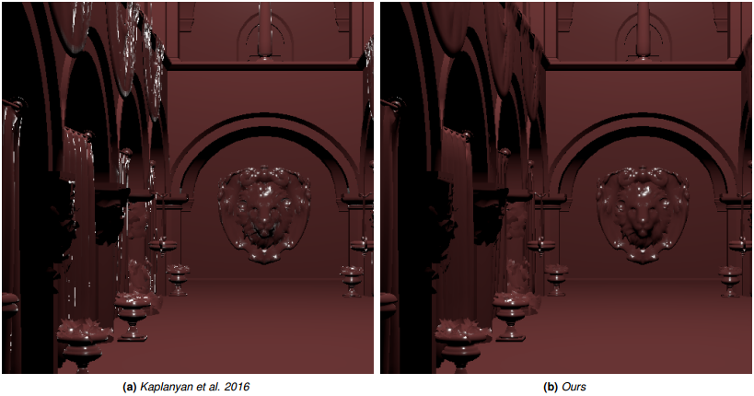
Multiscale Representation
Geometric curvature normal filtering important too
Useful for dense meshes without normal map
Curvature handled at pixel level [Kaplanyan16]
Improvement in [Tokuyoshi17]
Can be combined with normal map filtering
Image from “Error Reduction and Simplification for Shading Anti-Aliasing”, Y. Tukuyoshi, Tech report 2017
Notes:
[Kaplanyan16] A. Kaplanyan, Filtering Distributions of Normals for Shading Antialiasing, HPG 2016
[Tokuyoshi17] Y. tokuyoshi, Error Reduction and Simplification for Shading Anti-Aliasing, Tech report 2017 (http://www.jp.square-enix.com/tech/library/pdf/Error%20Reduction%20and%20Simplification%20for%20Shading%20Anti-Aliasing.pdf)
Anton: We provide a practical solution applicable for real-time rendering by employing recent advances in light transport for estimating the filtering region from various effects (such as pixel footprint) directly in the parallel-plane half-vector domain (also known as the slope domain), followed by filtering the NDF over this region

Slide 72
Multiscale Representation
Look for a real-time unified framework
Fold all pixel’s footprint surface information to an NDF
Geometry and normal map filtering add spikes on top of regular NDF (GGX)
Extra control to add procedural spikes (i.e glint)
For both diffuse and specular
There is very few research on filtering diffuse BRDF
Notes:
Almost not research on diffuse filtering, only LEADR speak about it
It is important to conserve the original shape of the NDF, previous paper tend to replace it by multiple Beckmann

Slide 73
Real-time BRDF
Going further?
More physically-accurate diffuse BRDF
NDF shape
Anisotropy, shape control
Multiscale Representation
Multiple scattering
Iridescence / Thin-film

Slide 74
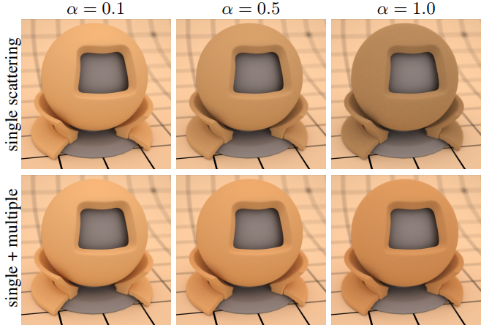
Multi-scattering
[Heitz16] Provide multi scattering GGX BRDF
Rougher is more saturated
For both diffuse and specular
Not real-time
Images from “Multiple-Scattering Microfacet BSDFs with the Smith Model”, E.Heitz, Siggraph 2016
Notes:
[Heitz16] E. Heitz, Multiple-Scattering Microfacet BSDFs with the Smith Model, Siggraph 2016
Will be a break changer for the artists, may require to re-author albedo.

Slide 75
Multi-scattering
Real-time approximation possible ?
[Kulla17] provides approximation of multiscattering with tabulated values
Idea from [Heitz14]
Second BRDF to compensate for the lost energy
Simulations show that
bounce lobes are similar
Images from “Multiple-Scattering Microfacet BSDFs with the Smith Model”, E.Heitz
Notes:
[Heitz14] E. Heitz, Understanding the Masking-Shadowing Function in Microfacet-Based BRDFs, JCGT
[Kulla17] C. Kulla, “Revisiting Physically Based Shading at Imageworks”, Siggraph 2017
Kulla approximation is similar approach than Kelemen et al in 2001.
Eric Heitz mentionned an approach that could be possible in real time. The bounce could be approximate by a second BRDF.
From simulation it appear the bounce lobe looks like a scaled version of the 1st bounce.
A cheap approximation could be to try to fit this scale factor (taking also into account Fresnel term) and apply it at the end of the lighting calculation (as lobe are identical).
Attempt have been done in non published work and are promising.

Slide 76
Real-time BRDF
Going further?
More physically-accurate diffuse BRDF
NDF shape
Anisotropy, shape control
Multiscale Representation
Multiple scattering
Iridescence / Thin-film

Slide 77
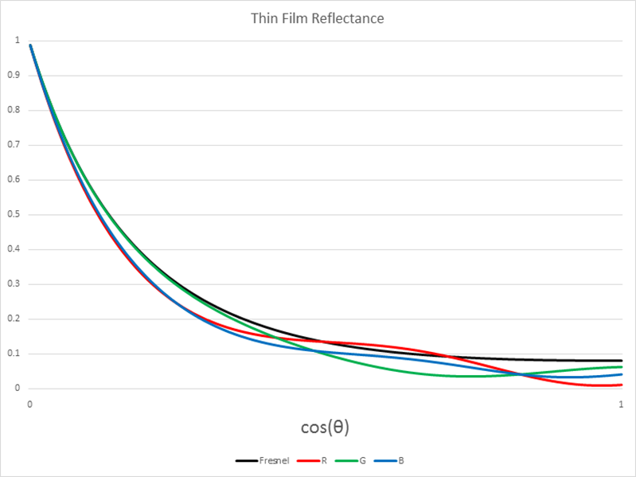
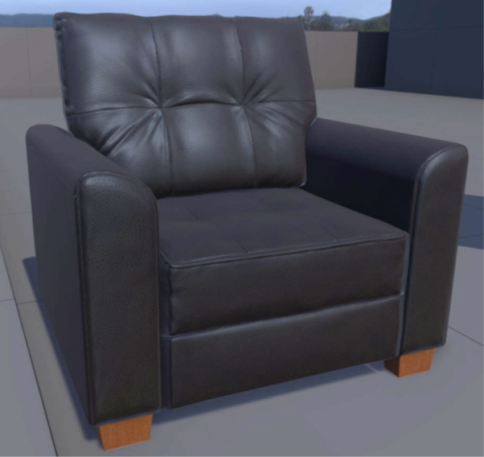
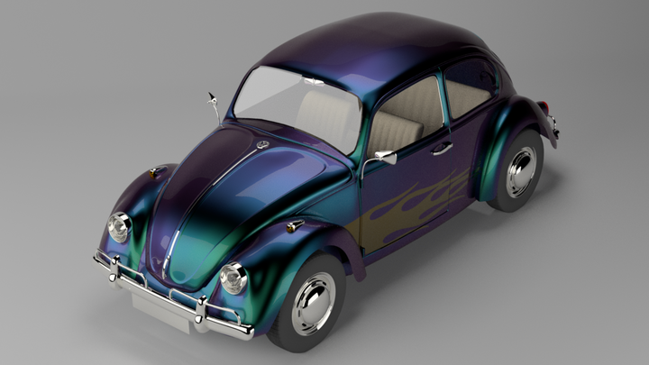
Iridescence / Thin-film
Iridescence / Thin-film
Chromatic Fresnel effect
Chromatic offset Fresnel curve [Drobot17]
Replace Fresnel term by Airy reflectance
[Belcour17]
Almost practical, multiscale, lighting coherency
Allows a similar visual to iridescent flakes
Needs a simpler parametrization
End of story?
Single thin-layer, not multi-layer (like butterfly)
Image from “Practical multi layered rendering”, M. Drobot, Siggraph 2017
Notes:
[Drobot17] M. drobot, Practical multi layered rendering, Siggraph 2017
Provide a hacked iridescence term based on shifting the Fresnel curve efficient for real time
[Belcour17] L. Belcour, A Practical Extension to Microfacet Theory for the Modeling of Varying Iridescence, Siggraph 2017
More physically based approach, need some optimization and simpler parametrization but very promising.

Slide 78
Our Vision for Unity
Layered, where are we
(in real-time rendering)?

Slide 79
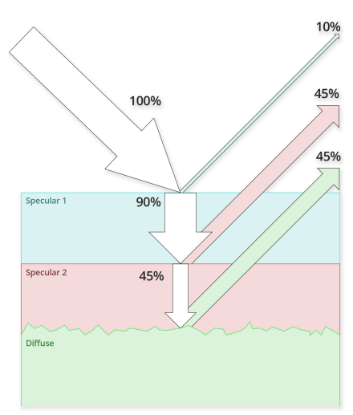
Layered BRDF
A layered BRDF is a stack of BRDFs
Games use 2 specular BRDF on top of a Diffuse BRDF
Hardcoded roughness and Fresnel interface
Mimic ClearCoat
Simplified
Need better rough Fresnel interface interaction
Image from “Physically Based Shader Design in Arnold”, A. Langlands, Siggraph

Slide 80
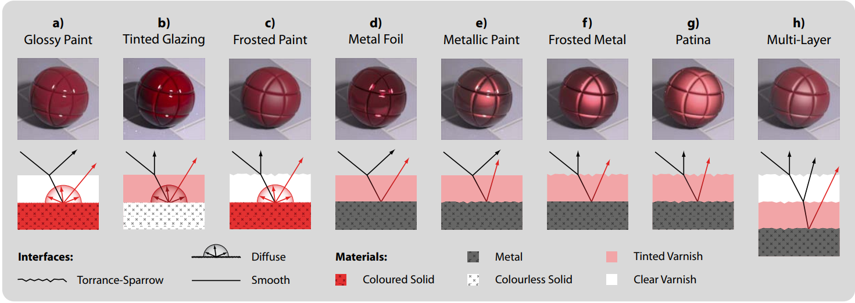
Layered BRDF
Two specular layers provide lot of combination for real times. Is that enough ?
Image from: “Arbitrarily Layered Micro-Facet Surfaces”, A. Weidlich, Graphite 2007

Slide 81
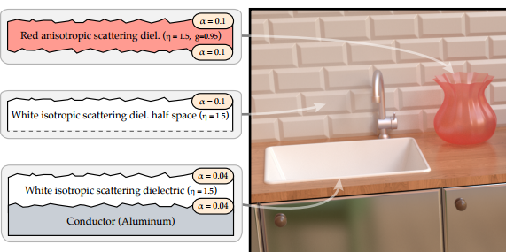
Layered BRDF
A hard problem with the Layered BRDF: Light transmission between layer
Multiple interface reflection in down/up directions
[Jakob14] Introduced tabulated reflectance functions in a Fourier basis for offline
Easy to chain
Produce accurate results for an
arbitrary number of layers
Image from “A Comprehensive Framework for Rendering Layered Materials”, w. Jakob, Siggraph 2014
Notes:
[Jakob14], w. Jakob, “A Comprehensive Framework for Rendering Layered Materials”, Siggraph 2014
One solution suggested by Jakob et al. iis to redistribute the lost energy in a near diffuse distribution in order to not lose energy. While it seems to be a coarse approximation, their results look plausible.

Slide 82
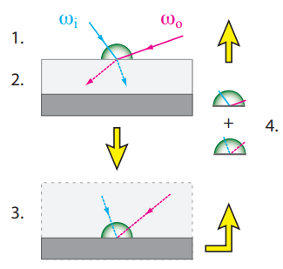
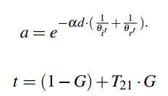
Layered BRDF
[Weidlich07] defines arbitrarily layered micro-facet surfaces
Specular layers only
Assumes single scattering thin layer
Approximate light transmission between layers (up and down)
Total internal reflection, absorption
No energy conservation
Image from “Arbitrarily Layered Micro-Facet Surfaces”, A. Weidlich, Graphite 2007
Notes:
[Weidlich07], A. Weidlich, “Arbitrarily Layered Micro-Facet Surfaces”, Graphite 2007
no energy conservation, single scattering
1. The BRDF of the topmost level fr1 is evaluated for the two given, arbitrary incoming directions ωi , and ωo. This yields a reflection component, and, except at the lowest layer, two refraction directions.
2. Any energy that is refracted into the next level T12 follows the two refraction directions associated with the initial incident directions, and is partly absorbed a by the medium.
3. These two refraction directions are assumed to meet at a single point on the next layer fr2 , and the process is repeated from step 1 until an opaque layer without a refraction component is encountered.
4. On returning from the recursion, the individual BRDF components are attenuated by the Fresnel transmission coefficients T21 for the level above them, and added to the total BRDF.

Slide 83
Layered BRDF
An important consideration for real-time layering
The top BRDF acts as a blurring filter on the bottom BRDF
Mean result can’t be sharper than input
Naturally handled by path tracer
Real-time needs to fake it
Should we consider roughness of top to modify the base roughness ?
Image from “Reflection Model Design for Wall-E and Up” B. Smiths, Siggraph 2012

Slide 84
Layered BRDF
Real-time layering base on [Weidlich07]
Layered Materials in Real-Time Rendering [Elek10]
Simulate path tracer blurring effect in layer
Use min of top and base roughness
Practical multi-layered rendering [Drobot17]
Improvement framework for “modern” PBR
Simulate path tracer blurring effect in layer
Use a mix of roughness, scattering and thickness
Notes:
[Elek10], O. Elek, “Layered Materials in Real-Time Rendering”, 2010
[Weidlich07], A. Weidlich, “Arbitrarily Layered Micro-Facet Surfaces”, Graphite 2007
[Drobot17] M. drobot, Practical multi layered rendering, Siggraph 2017

Slide 85
Layered BRDF
Previous approach approximates specular BRDF / specular BRDF interface
What about specular BRDF / diffuse BRDF interface ?
Fallback to previous section question
[Meneveaux17] multiple reflection Fresnel term ?
But smooth specular only
Notes:
[Meneveaux17] D. Meneveaux, Rendering Rough Opaque Materials with Interfaced Lambertian Microfacets, 2017
Remember introduction about dependency of BRDF lobes between layer

Slide 86
Layered BRDF
Which parametrization for IOR?
Games use specular (color)
Deduce IOR from D65 light and air-matter interface
Wrong to use it for underwater for example
Invertible for dielectric, not for conductor
Many engine use fixed 1.5 value for dielectric IOR
Layering needs the IOR ratio
Problematic with conductor base layer
Alternate parametrization for metals exists [Gulbrandsen14]
Image from “Artist Friendly Metallic Fresnel”, O.Gulbrandsen, JCGT 2014
Notes:
[Gulbrandsen14], O.Gulbrandsen, “Artist Friendly Metallic Fresnel”, JCGT 2014
IOR: index of refraction
We can determine the IOR at an extra cost. Perhaps it would be better to store a different encoding for a dieletric IOR since currently there is no standard storage representation. Most engines simply ignore it.
Switching to Gulbrandsen solution mean we should move to forward rendering. Gbuffer storage is prohibitive.

Slide 87
Our Vision for Unity
Physically-based textures

Slide 88
Physically-based textures
How to acquire physically-based textures?
Scan the real world with photogrammetry
Most practical and widely adopted solution
Scans also capture the lighting
Lighting is not a part of physically-based textures

Slide 89
Physically-based textures
How to extract BRDF parameters from a scan of a lit material?
Want individual BRDF parameters
Unlit diffuse albedo
Roughness
Open problem

Slide 90
Reconstruct unlit diffuse albedo ?
Goal: retrieve object’s illumination at the time of capture
Use this information to remove lighting from the texture
Notes:
Removing illumination is simply dividing the lit material by the recovered light. We assume Lambertian surface.

Slide 91
Capture Object’s illumination?
Use an HDRI from capture location [Antoine15]
HDRI position matters for big objects
Take multiple HDRI?
Outdoor lighting condition changes quickly
Time consuming
Image from “The Tech & art behind Epic’s UE4 Open World Demo”, F. Antoine, GDC 2015
Notes:
[Antoine15] F. Antoine, “The Tech & art behind Epic’s UE4 Open World Demo”, GDC 2015

Slide 92
Capture Object’s illumination?
Reconstruct a pre-convolved HDRI from the reconstructed lit mesh [Jover17]
Fast, no extra input
Works with large objects
Looks promising!
Photogrammetry Workflow and the tech behind the delighting tool, Wednesday 2 August - Unity Central Room - 503 - 11:00am
https://labs.unity.com/article/experimental-feature-de-lighting-tool
Notes:
Please test our Unity De-lighting tool and tell us what you think :)

Slide 93
Capture Object’s illumination?
Throwing ideas inspire by [Duchene15]
Use photogrammetry pictures
Reconstruct HDRI from a set of pictures?
Remove lighting from pictures before projecting onto the reconstructed mesh?
Image from “Multi-View Intrinsic Images of Outdoors Scenes with an Application to Relighting”, S. Duchene, 2015
Notes:
[Duchene15] S. Duchene, “Multi-View Intrinsic Images of Outdoors Scenes with an Application to Relighting”, 2015
They split lighting and reflectance using a multiple view picture set

Slide 94
Retrieve roughness?
Unity experiment
Take samples at varying elevation angles with aligned flash & camera
Based on a modified version of [Dupuy15]
Seems to work, but not practical
24H processing time for 4K textures…
Notes:
[Dupuy15] J. Dupuy, Extracting Microfacet-based BRDF Parameters from Arbitrary Materials with Power Iterations, EGSR 15
(L == V, mean backscatter)
Requires a normal map
Direct evaluation (no optimization problem)
Brute force processing that says which roughness match a particular backscatter intensity
For a pixel in the smoothness map, we will take all the angles, check into a table, use the algorithm from the paper, then extract roughness
It use a set of images at different angle. For grazing angle, our artists have manually align the pixles

Slide 95
Retrieve roughness?
Promising research available
Sparse-as-Possible SVBRDF Acquisition[Zhou16]
From set of images + Geometry + Lighting
Two-Shot SVBRDF Capture for Materials [Aittala15]
Could be practical
Key point: Should be easy for artists to experiment
Image from “Sparse-as-Possible SVBRDF Acquisition”, Z. Zhou, Siggraph Asia 2016
Notes:
[Aittala15] M. Aittala, “Two-Shot SVBRDF Capture for Stationary Materials”, Siggraph 2015
This paper take set of images, geometry and HDRI as input (i.e what you have with photogrammetry) and extract the BRDF parameters
[Zhou16] Z. Zhou, “Sparse-as-Possible SVBRDF Acquisition”, Siggraph Asia 2016
This paper use two inputs: with and without flash pictures of a material and provide the material BRDF parameters.
The problem with this kind of papers is that there is no way for an artists to experiment it. Implementing a paper like this is extremely complex and even where there is matlab source (like for Aittala), there is no way an artists can make anything with that. It require at least a command line program.

Slide 96
Machine learning?
Generating virtual data is not always simple
Generate virtual lit/unlit data: OK. Roughness?
Need to compute normal distribution of the mesh and fit it to an NDF to recover roughness parameters ?
Mean very dense mesh
Getting representative assets is very challenging
Few research available
Reflectance Modeling by Neural Texture Synthesis [Aittala16]
Image from “Reflectance Modeling by Neural Texture Synthesis”, M. Aittala, siggraph 2016
Notes:
Obvious trend: Try deep learning? When you don’t know what to do.
The problem with deep learning is first to find the data. And finding a large amount of “correct” data, is often not possible. Better to rely on generation. But then, how to generate representative roughness map ?
[Aittala16], Reflectance Modeling by Neural Texture Synthesis, Siggraph 2016
Use a single image with Flash to recover texture

Slide 97
Machine learning?
Research effort at Unity for unlit case
Partnership with Berkeley University
Based only on texture data
Inputs: Lit diffuse /
bent normal map /
ambient occlusion
Outputs: Unlit diffuse
Try various input combinations
Works best for lit diffuse only...
Project Managers: Michael Zhang, Zhongxia “Zee” Yan
Members: Murtaza Dalal, Quinn Tran, Varsha Ramakrishnan, Tracy Lou, Gefen Kohavi
Notes:
Training time: 32x32 slice
Test time: 1024x1024

Slide 98
Machine learning?
Results: blurry, but promising. Further research is needed.
Project Managers: Michael Zhang, Zhongxia “Zee” Yan
Members: Murtaza Dalal, Quinn Tran, Varsha Ramakrishnan, Tracy Lou, Gefen Kohavi
Notes:
Future may be a mix of artists tools and deep learning

Slide 99
Our Vision for Unity
Conclusion

Slide 100
Conclusion
What could be a future general physically-based material for real time?
Layered BRDF: 2 specular BRDF + Diffuse BRDF
All derives from the same anisotropic NDF
Energy conserving: MultiScattering, Fresnel interfaces
Option to switch to Airy reflectance Fresnel
Shape-invariant “matching measure” NDF
Multiscale Diffuse and Specular representation
Require to move to forward+ with all parameters ?

Slide 101
Conclusion
And need to capture physically-based textures for such a material based on a photogrammetry workflow
Physically-based materials are hard!
And we’ve only scratched the surface with BRDFs
Subsurface scattering, volume, transparency even more complex
Diffraction ?
Not the only part of the equation
Physically-based lighting even more important

Slide 102
Acknowledgements
Aaron Lefohn, Natalya Tatarchuk
Naty Hoffman, Eric Heitz, Jonathan Dupuy, Laurent Belcour, Evgenii Golubev, Charles de Rousiers, Brian Karis, Sébastien Hillaire, Emmanuel Turquin, Cyril Jover, Sébastien Lachambre: Discussion and help

Slide 104
Our Vision for Unity
Questions ?
Lagardese@hotmail.fr
Twitter: @seblagarde

Slide 105
References
[Aittala15] M. Aittala, “Two-Shot SVBRDF Capture for Stationary Materials”, Siggraph 2015 [Aittala16], Reflectance Modeling by Neural Texture Synthesis, Siggraph 2016
[Antoine15] F. Antoine, “The Tech & art behind Epic’s UE4 Open World Demo”, GDC 2015 [Atanasov15] A. Atanasov, A Practical Stochastic Algorithm for Rendering Mirror-Like Flakes, Chaos group documentation 2015
[Bagher12] M. Bagher, “Accurate fitting of measured reflectances using a Shifted Gamma micro-facet distribution”, 2012
[Becker93] B. Becker, Smooth Transitions between Bump Rendering Algorithms, Siggraph 1993
[Belcour17] L. Belcour, A Practical Extension to Microfacet Theory for the Modeling of Varying Iridescence, Siggraph 2017
[Burley12] B. Burley, Physically based shading at Disney, Siggraph 2012
[Dimov15] R.Dimov, Deriving the Smith shadowing function G1 for γ in (0, 4], Chaos group documentation 2015
[Dupuy13] J. Dupuy, E. Heitz, Linear Efficient Antialiased Displacement and Reflectance Mapping, 2013 [Dupuy15] J. Dupuy, Extracting Microfacet-based BRDF Parameters from Arbitrary Materials with Power Iterations, EGSR 2015 [Drobot17] M. drobot, Practical multi layered rendering, Siggraph 2017
[Elek10], O. Elek, “Layered Materials in Real-Time Rendering”, 2010 [Fujii] Y. Fujii, A A tiny improvement of Oren-Nayar reflectance model
[Gotanda12] Y. Gotanda, Beyond a Simple Physically Based Blinn-Phong Model in Real-Time, Siggraph 2012
[Gotanda14] U. Gotanda, Designing Reflectance Models for New Consoles, Siggraph 2014 [Gotanda15] Y. Gotanda, Designing Physically Based Microfacet Models for Next Generation, Cedec 2015
[Gulbrandsen14], O.Gulbrandsen, “Artist Friendly Metallic Fresnel”, JCGT 2014 [Hammon17] E. Hammon, PBR Diffuse Lighting for GGX+Smith Microsurfaces, GDC 2017
[Heitz14] E. Heitz, Understanding the Masking-Shadowing Function in Microfacet-Based BRDFs, JCGT [Heitz15] E. Heitz, Implementing a Simple Anisotropic Rough Diffuse Material with Stochastic Evaluation, 2015
[Heitz16] E. Heitz, Multiple-Scattering Microfacet BSDFs with the Smith Model, Siggraph 2016
[Heitz16b] E. Heitz, “Real-time polygonal-light shading with linearly transformed cosines”, Siggraph 2016
[Holzschuch17] N. Holzschuch, A Two-Scale Microfacet Reflectance Model Combining Reflection and Diffraction, Siggraph 17

Slide 106
References
[Jakob14] W. Jakob, Discrete Stochastic Microfacet Models, Siggraph 2014 [Jakob14b], W. Jakob, “A Comprehensive Framework for Rendering Layered Materials”, Siggraph 2014
[Jover17] C. Jover, “The Tech behind the Unity De-Lighting tool”, 2017
[Kaplanyan16] A. Kaplanyan, Filtering Distributions of Normals for Shading Antialiasing, HPG 2016
[Karis13] B. Karis, “Real Shading in Unreal Engine 4”, Siggraph 2013
[Lagarde14] S. Lagarde, C. De Rousiers, Moving Frostbite to Physically based Rendering, Siggraph 2014
[McAuley15] S. McAuley, The rendering of far cry 4, Cedec 2015
[McGuire16], M. McGuire, Peering Through a Glass, Darkly at the Future of Real-Time Transparency, Siggraph 2016
[Meneveaux17] D. Meneveaux, Rendering Rough Opaque Materials with Interfaced Lambertian Microfacets, 2017
[MERL06] https://www.merl.com/brdf/
[Nagano15] K. Nagano, Skin Microstructure Deformation with Displacement Map Convolution, Siggraph 2015
[Olano10] M.Olano, D.Baker, Lean Mapping, I3D 2010
[Oren94], M. Oren, S. Nayar, Generalization of Lambert’s Reflectance Model, Siggraph 1994
[Pesce15] A. Pesce, M. Iwanicki, Approximate Models For Physically Based Rendering, Siggraph 2015
[Raymond16], B. Raymond, Multi-Scale Rendering of Scratched Materials using a Structured SV-BRDF Model, Siggraph 16
[Revie11] D. Revie, Implementing Fur Using Deferred Shading, GPU Pro 2 [Ribardiere17] STD: Student’s t-Distribution of Slopes for Microfacet Based BSDFs, eurographics 2017
[Shirley97] P. Shirley, A Practitioners’ Assessment of Light Reflection Models, 1995 Equation (5)
[Toksvig04] M. toksvig, Mipmapping Normal Maps, 2014
[Tokuyoshi17] Y. tokuyoshi, Error Reduction and Simplification for Shading Anti-Aliasing, Tech report 2017 [Xu17] C. Xu, Real-Time Linear BRDF MIP-Mapping, Eurographic 2017
[Yan16], L. Yan, Position-Normal Distributions for Efficient Rendering of Specular Microstructure, Siggraph 2016 [Zirr] T. Zirr, Real-time Rendering of Procedural Multiscale Materials, I3D 2016
[Zhou16] Z. Zhou, “Sparse-as-Possible SVBRDF Acquisition”, Siggraph Asia 2016

Slide 107
Our Vision for Unity
Bonus slides
Lagardese@hotmail.fr
Twitter: @seblagarde

Slide 108
Physically based material ?
Shape invariance?
Stretched surface becomes smoother and compressed surface becomes rougher
Skin deformation during facial animation [Nagano15]
Easier to handle with shape invariance property
Image from “Skin Microstructure Deformation with Displacement Map Convolution”, K. Nagano, Siggraph 2015 and “Linear Efficient Antialiased Displacement and Reflectance Mapping”, J. Dupuy, 2013
Notes:
[Nagano15] K. Nagano, Skin Microstructure Deformation with Displacement Map Convolution, Siggraph 2015
Since the skin surface is relatively stiff, it develops a rough microstructure to effectively store a reserve of surface area to prevent rupturing when extended. Thus, parts of the skin which stretch and compress significantly (such as the forehead and around the eyes) are typically rougher than parts which are mostly static, such as the tip of the nose or the top of the head. When skin stretches, the microstructure flattens out and the surface appears less rough as the reserves of tissue are called into action. Under compression, the microstructure bunches up, creating micro-furrows which exhibit anisotropic roughness. Often, stretching in one dimension is accompanied by compression in the perpendicular direction to maintain the area of the surface or the volume of tissues below. A balloon provides a clear example of roughness changes under deformation: the surface is diffuse at first, and becomes shiny when inflated
https://spiral.imperial.ac.uk/bitstream/10044/1/23615/2/skinstretch-final-small.pdf

Slide 109
More Physical diffuse BRDF
[Gotanda15] approximation
isotropic GGX + Height-Correlated visibility term
Image from “Designing Reflectance Models for New Consoles”, Y. Gotanda, Siggraph 2014
Notes:
[Gotanda15] Y. Gotanda, Designing Physically Based Microfacet Models for Next Generation, Cedec 2015
Note the energy conserving term used (Left), the resulting 21/20 PI (1 - fo) seems a convenient approximation

Slide 110
Energy conservation
Energy conservation between diffuse and specular?
Several conceptual approach exist
Mean different results
Let’s see two of them
Multi-layered and interfaced Lambertian microfacets
Image from “Rendering Rough Opaque Materials with Interfaced Lambertian Microfacets, D. Meneveaux, 2017

Slide 111
Energy conservation
Multi-layered
A specular BRDF layer on top of a Diffuse BRDF
A BRDF can have one or several lobes
Diffuse and specular are uncorrelated
Each have different properties
Diffuse (aniso) roughness, specular (aniso) roughness
Notes:
Diffuse and specular can be perceived as an aggregation of BRDF
For example, Jakob et al. suggest to reintroduce the energy loss as a diffuse radiation in reflection and transmission so that the energy is conserved. W

Slide 112
Energy conservation
Interfaced Lambertian microfacets
Uber BRDF: Diffuse + Specular
Diffuse and specular are correlated
Share properties
One (anisotropic) roughness

Slide 113
Energy conservation
What is the difference ?
Comparison done by [Meneveux17]
As roughness increases
Interfaced BRDF exhibits backscattering (flat look)
Layered BRDF has a Lambertian behavior
Roughness increase
Interfaced Lambertian
Layered
Image from “Rendering Rough Opaque Materials with Interfaced Lambertian Microfacets, D. Meneveaux, 2017
Notes:
[Meneveaux17] D. Meneveaux, Rendering Rough Opaque Materials with Interfaced Lambertian Microfacets, 2017 (in supplemental)

Slide 114
Energy conservation
Diffuse BRDF - Facet BRDF
No edge darkening as simple Lambertian microfacet
Image from “Implementing a Simple Anisotropic Rough Diffuse Material with Stochastic Evaluation”, E. Heitz, 2015
Notes:
As you can see, when defining a diffuse BRDF uncorrelated to specular BRDF it doesn’t include darkening at edge. The energy conservation will come from layer interface.

Slide 115
Physically based material ?
So far, we have discussed vertical layering only
But what about horizontal layering (i.e. mixing BRDFs)?
With distance BRDFs are mixed in pixel’s footprint
Simple: evaluate all BRDFs and weight the results
Blending parameters is wrong
Very hard in practice in real time
Even more complex than multiscale BRDFs
Fresnel can change as well
Could be approximated by adding constraints?

Slide 116
Multiscale
Non smooth NDF ?
Glint/Spiky BRDF
Some materials exhibit a bright sparkling or glittering surface
Sand, snow or frost (ice crystals)
Rock (mica-flakes), metallic paints (mirror-flakes)
Brushed and scratched metal…
Images from “How to design your assets for physically based rendering”, Y. Gotanda, Cedec 2012
Notes:
Due to bumps and flakes

Slide 117
Layered BRDF
Weidlich and Wilkie’s approach is compatible with the general microfacet equation
Just add one layer [Gotanda15]
Image from “Designing Physically Based Microfacet Models for Next Generation”, Y. Gotanda, Cedec 2015
Notes:
[Gotanda15] Y. Gotanda, Designing Physically Based Microfacet Models for Next Generation, Cedec 2015
Note: Gotanda here don’t use GGX diffuse but just 1 / PI

